Slide 1

Multi-User Banking System with Inheritance
This presentation outlines the development of a sophisticated banking system. It features various account types, leveraging inheritance for efficient management.

Slide 2


Project Overview
System Goals
Technical Details
Inheritance Model
Simulate banking environment
Java (JDK 17+) for logic
Core Account base class
Manage user accounts
MySQL for data storage
Savings Account subclass
Process transactions efficiently
IntelliJ/Eclipse for development
Current Account subclass

Slide 3



Project Setup: JDK & IDE
1
JDK Installation
2
IDE Configuration
Ensure Java Development Kit 17+ is installed. This is crucial for compilation and runtime.
Install and configure Visual Code or Eclipse. These IDEs enhance productivity.
3
New Project Creation
Create a new Java project within your chosen IDE. Select Maven or Gradle for dependencies.

Slide 4
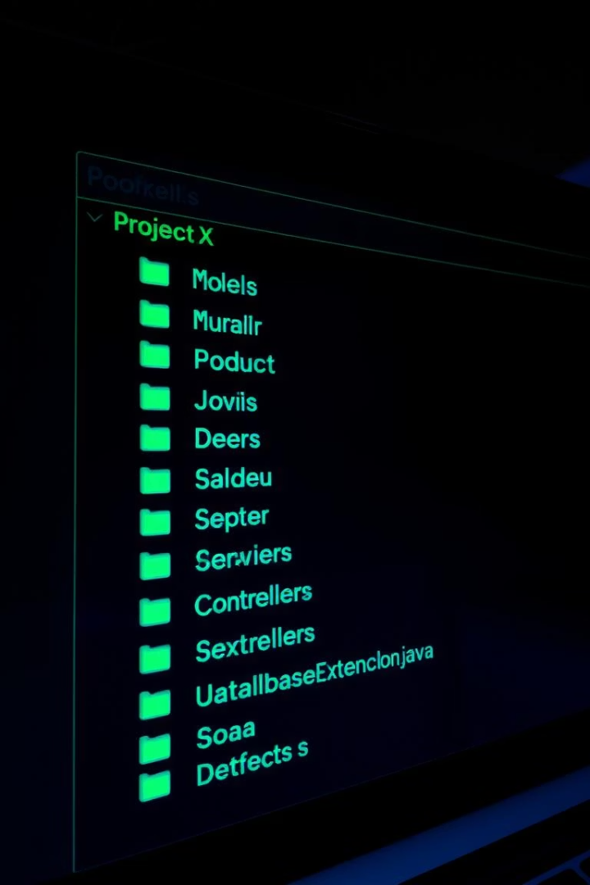
Project Structure
Model Package
Contains core data classes: Customer, Account. Represents the banking entities.
DAO Layer
Data Access Objects for database interactions. Handles persistence operations.
Service Layer
Implements business logic and orchestrates operations. Connects controllers and DAOs.
Controller & Exceptions
Controllers manage user input. Exceptions handle error scenarios gracefully.

Slide 5
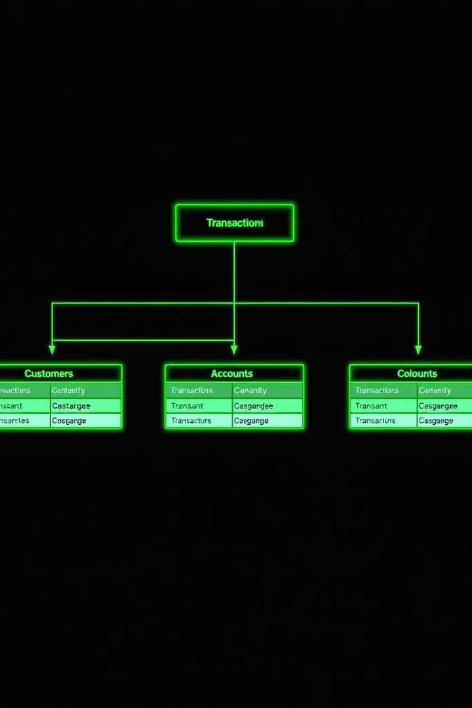
Database Schema Design
Table Name
Key Columns
Customers
customer_id, name, address, contact
Accounts
account_id, customer_id, account_type, balance, interest_rate, withdrawal_limit
Transactions
transaction_id, account_id, transaction_date, amount, type
The database schema includes three main tables. Customers stores user details. Accounts holds account-specific information. Transactions logs all financial movements.

Slide 6
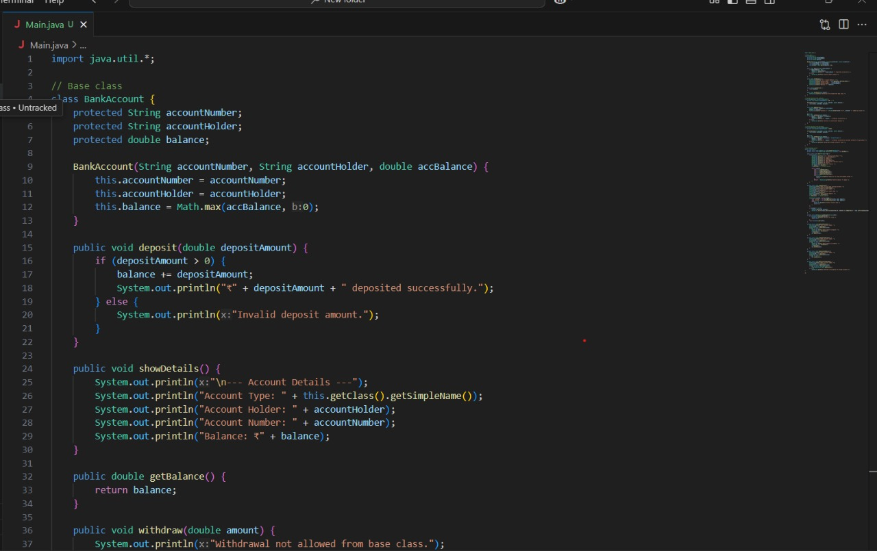
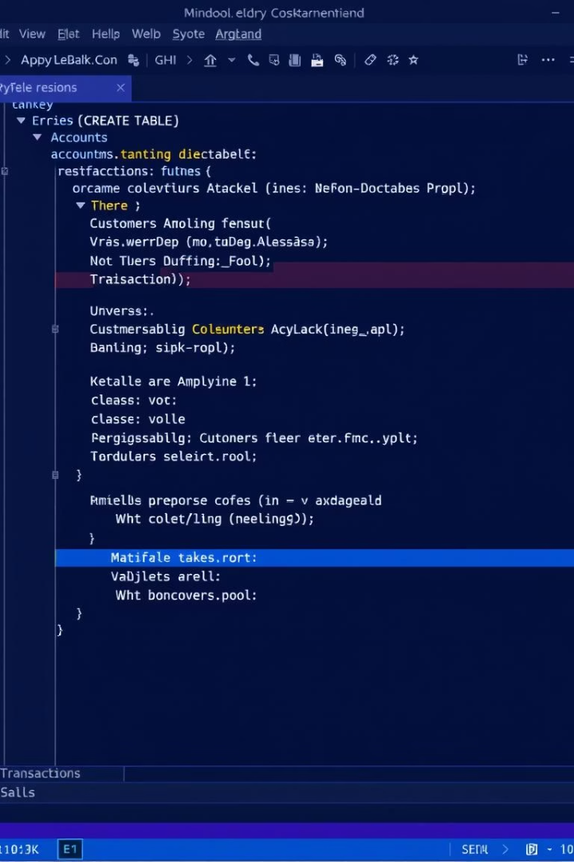
MySQL Table Creation
CREATE TABLE Users ( user_id INT PRIMARY KEY, username VARCHAR(50), password VARCHAR(255), email VARCHAR(100) ); CREATE TABLE Accounts ( account_id INT PRIMARY KEY, user_id INT, account_type ENUM('Savings', 'Current'), balance DECIMAL(15, 2), FOREIGN KEY (user_id) REFERENCES Users(user_id) ); CREATE TABLE Transactions ( transaction_id INT PRIMARY KEY, account_id INT, type ENUM('Deposit', 'Withdrawal', 'Transfer'), amount DECIMAL(15, 2), timestamp TIMESTAMP DEFAULT CURRENT_TIMESTAMP, FOREIGN KEY (account_id) REFERENCES Accounts(account_id) );

Slide 7













JDBC Connectivity
Driver Dependency
Connection Pool
Add JDBC driver for database connection. Essential for communication.
Implement HikariCP for efficient connections. Manages database resources.
Error Handling
DAO Interaction
Robust exception handling for database issues. Ensures system stability.
DAO classes handle all database operations. They manage data persistence.

Slide 8






Model Classes
User
1
Holds customer details
Account (Abstract)
2
Base for all accounts
Savings Account
3
Includes interest rates
Current Account
4
Features overdraft limits
Transaction
5
Records all activities
Our model classes are structured using inheritance, with an abstract Account class. This design promotes code reusability and ensures consistency across different account types.

Slide 9
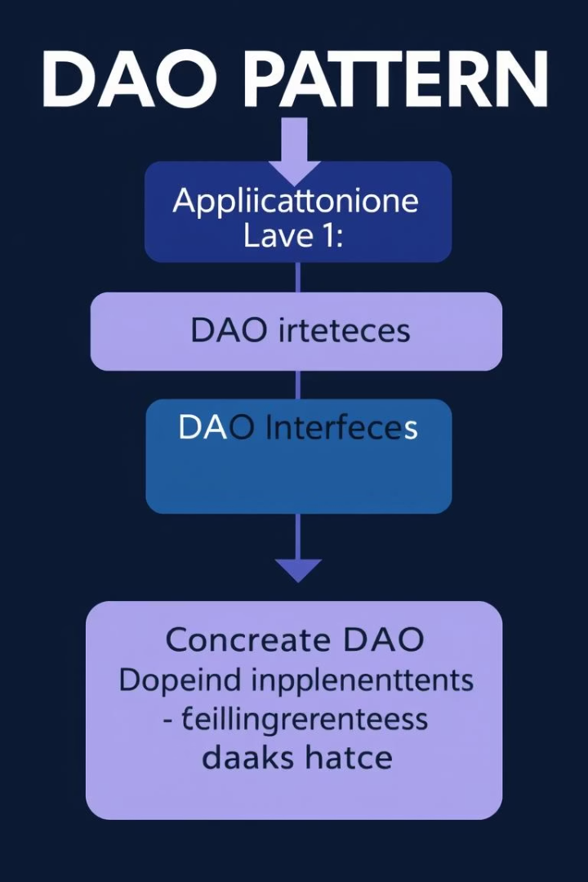



DAO (Data Access Object) Classes
UserDAO
Manages user data access
AccountDAO
Handles account operations
TransactionDAO
Processes transaction records
DAO classes abstract data persistence. They provide a clean interface for CRUD operations. This separation improves modularity and maintainability.

Slide 10
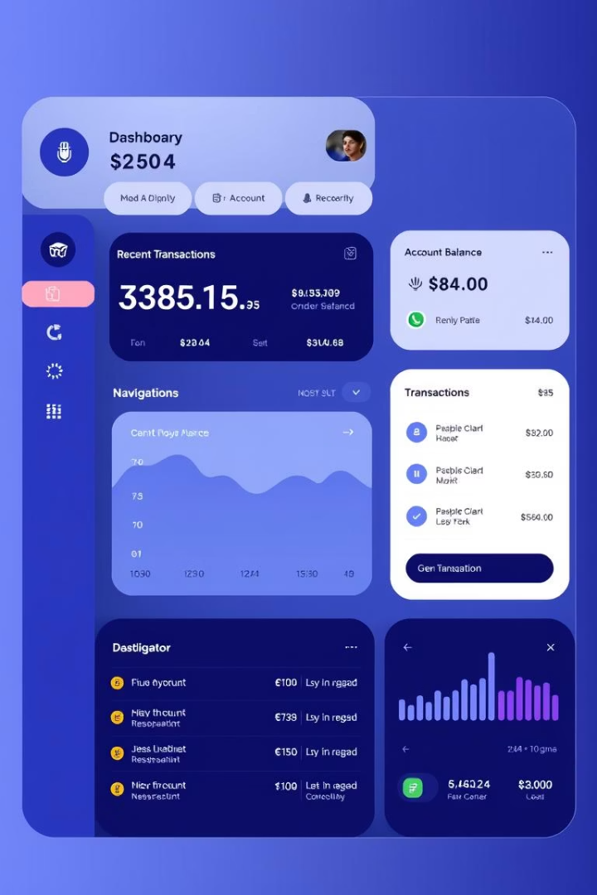
UI Design & Aesthetics
Login Screen
Account Dashboard
Secure user authentication
Overview of balances and accounts
Transaction History
Detailed records of activities
The UI emphasizes user experience. Wireframes guide layout, while mockups define the visual style. Components like text fields and tables ensure intuitive interaction.

Slide 11

Component Alignment, Accessibility, & Responsible Coding
1
Architecture Alignment
All components align with the project architecture. Ensures consistency.
2
Robust Error Handling
Implement try-catch for all exceptions. Prevents system crashes.
3
Comprehensive Logging
Apply logging to track all actions. Aids debugging and auditing.
4
Secure Practices
Follow secure coding guidelines. Protects against vulnerabilities.

Slide 12
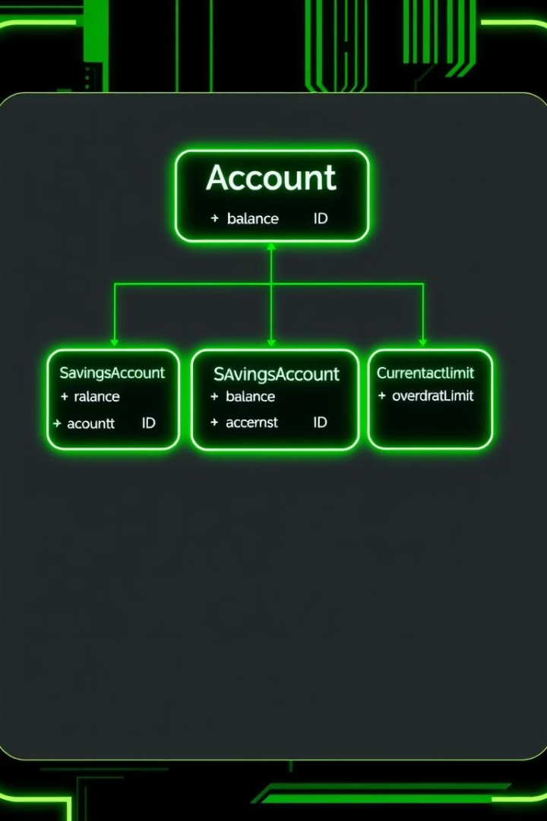




Account Type Inheritance
Account (Base)
Common attributes: account_id, customer_id, balance. Foundation for all accounts.
SavingsAccount
Extends Account with interest_rate. Earns interest on balance.
CurrentAccount
Extends Account with withdrawal_limit. Features flexible withdrawals.
Methods
Deposit, withdraw, calculate interest. Core banking operations.

Slide 13

Concept: Banking System with Inheritance
Customer Accounts
Inheritance Model
Customizable Rates
Supports multiple customers with various account types. Each customer can hold different accounts.
Defines account types using inheritance for structure. This promotes code reuse and flexibility.
Savings and Current accounts have unique features. Interest rates and withdrawal limits vary.

Slide 14

Conclusion
Completed core banking components
Flexible account types via inheritance
Robust database integration
User-friendly interface design
The banking system provides a solid foundation. Future enhancements could include advanced security and a mobile application. Next steps involve rigorous testing and deployment.

